Slide 1

UCB Data Analysis Bootcamp Group Project 1 Dhwani Shah, Eduardo Gonzales, Johnathan Tran, Justin Nolan July 2024

Slide 2


Crime Chronicles
Scope analysis of crime rate in California based on the changes in the rate of inflation.

Slide 3
Research Questions
How have crime rates in California changed from 1998 to 2023?
What are the long-term trends in different types of crime (e.g., violent crimes, property crimes) over this 25-year period?
Is there a correlation between annual inflation rates and overall crime rates in California over the past 25 years?
How does inflation impact different types of crime (e.g., theft, burglary, assault) over this period?

Slide 4
Data Source:

Slide 5
Data Cleanup and Exploration:

Slide 6
Data Analysis :
Refer t o the Jupyter Notebook at :
https://github.com/EdGonz44/Crime-Chronicles-Inflation-in-the-Golden-State/blob/main/group_project/VisualizationData.ipynb

Slide 7
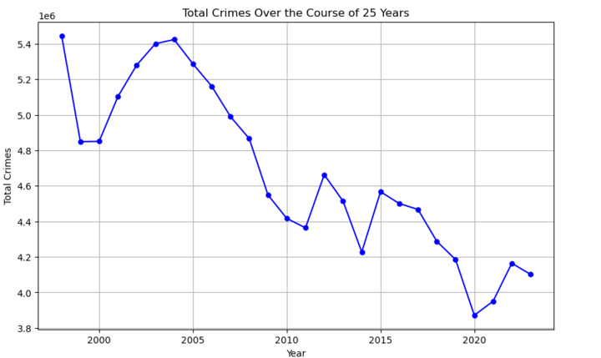
HOW HAVE CRIME RATES IN CALIFORNIA CHANGED FROM 1998 TO 2023 ?
Summary Analysis:
The chart titled "Total Crimes Over the Course of 25 Years" illustrates the following key points:
Overall Decline: From 1998 to 2023, total crimes significantly decreased from approximately 5.4 million to around 4.0 million.
Fluctuations: Despite the general decline, there were periods of fluctuation, particularly in the early 2000s and around 2015.
Recent Trends: Post-2018, crime rates decreased further, reaching a low around 2020, followed by a slight increase up to 2023.
Conclusion:
The data shows a notable long-term reduction in crime rates over the past 25 years. However, the observed fluctuations and recent minor increases suggest that ongoing efforts are needed to understand and address the factors influencing these trends. Continuous research and policy adjustments are essential to maintain and further the progress in reducing crime rates.

Slide 8
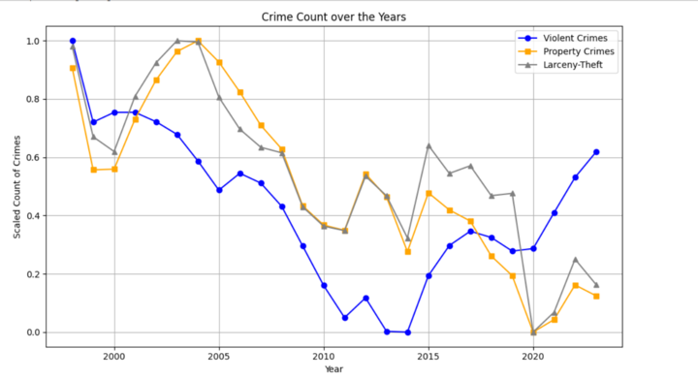
What are the long-term trends in different types of crime over this 25-year period?
Summary Analysis :
The chart "Crime Count over the Years" illustrates the trends in Violent Crimes, Property Crimes, and Larceny-Theft from the late 1990s to 2023.
Violent Crimes (Blue Line):
Declined significantly from the late 1990s to 2013.
Increased notably post-2017, peaking around 2023.
Property Crimes (yellow Line):
Fluctuated with a general decline from the late 1990s to 2020.
Slight increase post-2020.
Larceny-Theft (grey Line) :
Showed similar fluctuation and decline to property crimes.
Slight increase post-2020.
Conclusion:
The chart indicates a significant long-term decline in all crime categories from the late 1990s to 2020, reflecting improvements in public safety. However, the recent uptick in violent crimes and slight increases in property crimes and larceny-theft post-2020 suggest emerging challenges that need to be addressed to maintain the progress in crime reduction.

Slide 9
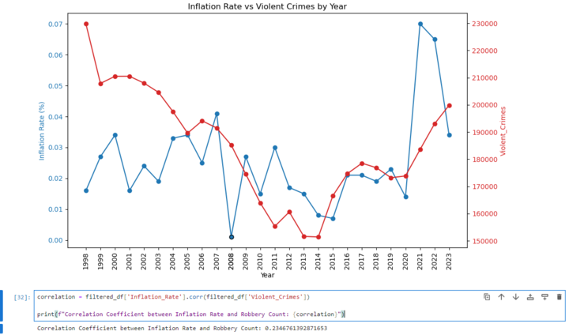
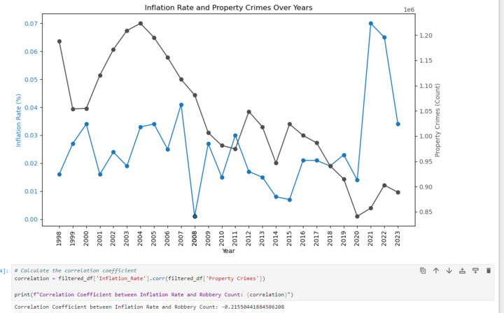
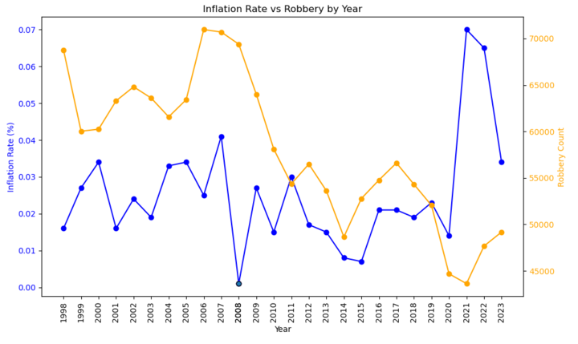
Is there a correlation between annual inflation rates and overall crime rates in California over the past 25 years?
Summary Analysis :
Inflation Rate and Property Crimes Over Years
Inflation Rate (Blue Line): Peaks around 2008-2009 and 2021-2022.
Property Crimes (Black Line): General decline from 1998 to 2023 with fluctuations.
Correlation Coefficient: -0.2155044188456208, indicating a weak negative correlation.
Inflation Rate vs Violent Crimes by Year
Inflation Rate (Blue Line): Shows significant peaks similar to the previous graph.
Violent Crimes (Red Line): Generally declining trend with fluctuations, noticeable increase post-2017.
Correlation Coefficient: 0.2346761392871653, indicating a weak positive correlation.
Inflation Rate vs Robbery by Year
Inflation Rate (Blue Line): Peaks in the same periods.
Robbery Count (Orange Line): General decline with fluctuations, significant spike around 2008-2009 and 2021-2022.
Correlation Coefficient: Not directly shown in the image but can be inferred as weak based on trends.
Correlation Summary:
Inflation Rate and Property Crimes: Weak negative correlation (-0.22), suggesting that higher inflation might slightly decrease property crimes.
Inflation Rate and Violent Crimes: Weak positive correlation (0.23), suggesting that higher inflation might slightly increase violent crimes.
Inflation Rate and Robbery: Trends suggest a weak correlation, likely weak positive or neutral.
Conclusion:
The correlations between the inflation rate and different crime types are generally weak. The weak negative correlation with property crimes and weak positive correlation with violent crimes indicate that inflation might have some influence, but other factors likely play a more significant role in crime trends. The fluctuation patterns and recent spikes in both inflation and crime rates during specific periods (e.g., economic crises) highlight the complex interplay between economic conditions and crime. Further analysis with more variables would provide a clearer understanding of these relationships.

Slide 10
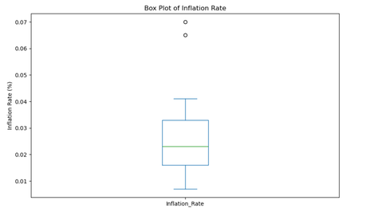
The box plot analysis of inflation rate from 1998 to 2023
Summary:
The box plot visually represents the distribution of inflation rates from 1998 to 2023. Key statistical measures such as the median, quartiles, and outliers are depicted, providing insights into the variability and central tendency of inflation rates over this period.
Median (Q2): The median inflation rate appears to be around 2%.
Outlier : The outlier year (likely with a significantly higher inflation rate) stands out from the rest of the data. This could be a year of economic significance where external factors like economic crises or policy changes might have influenced inflation rates.
Temporal Analysis: Considering the years plotted, the box plot doesn't show a significant trend over time but rather captures the variability and outlier years.
To find correlation, identifying outlier years is crucial as they can provide insights into periods of economic stress or unusual policy interventions affecting inflation.
Conclusion:
The box plot analysis provides a clear visual representation of the distribution and outlier in inflation rates, offering valuable insights into economic stability, policy impacts, and historical trends. Further investigation into the outlier year can provide deeper understanding and inform strategic decisions in economic policy and forecasting.

Slide 11
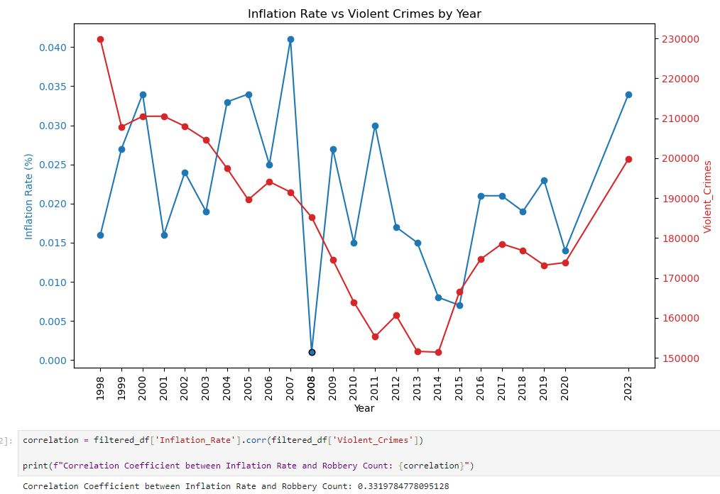
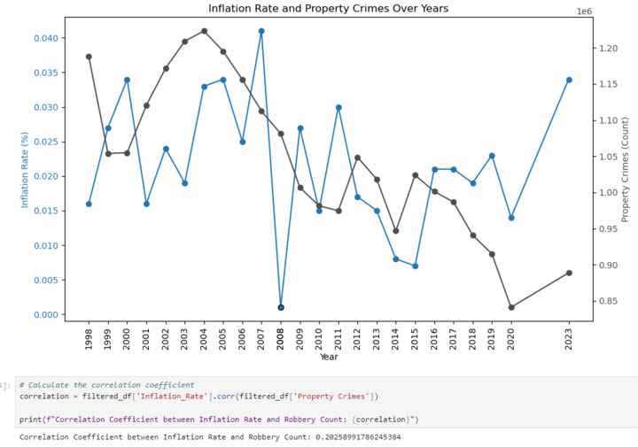
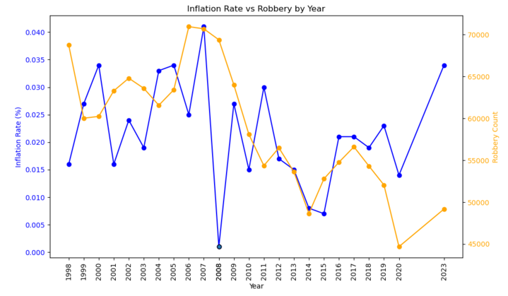
Correlation Analysis After Removing Outliers.
Summary Analysis:
After removing the outlier years (2008, 2009, 2021, 2022), the correlation coefficients between the inflation rate and different crime types are as follows:
Inflation Rate and Violent Crimes:
Correlation Coefficient: 0.331
Interpretation: There is a weak positive correlation, suggesting that an increase in the inflation rate is slightly associated with an increase in violent crimes.
Inflation Rate and Property Crimes:
Correlation Coefficient: 0.202
Interpretation: There is a very weak positive correlation, indicating that changes in inflation rate have a minimal effect on property crime rates.
Inflation Rate and Robbery:
Correlation Coefficient: 0.214
Interpretation: There is a weak positive correlation, indicating that higher inflation rates are somewhat associated with an increase in robbery counts.
Conclusion:
Even after removing the outliers, the correlations between the inflation rate and different crime types remain weak. This suggests that while there may be a slight relationship between inflation and crime rates, other factors likely have a more significant impact on crime trends. The weak positive correlations indicate that higher inflation rates might be associated with increases in crime rates, but the relationship is not strong enough to draw definitive conclusions without considering additional variables.

Slide 12
Conclusion:

Slide 13
Reference :

Slide 14

Thank-You

